Slide 1
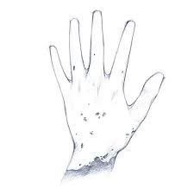
Skin Diseases Identification Using Image Analysis
TEAM-02
K.B.S.Priyanka
P.LoukySree
Y.R.Aahlad
O.Poojitha
K.Sonali

Slide 2

CONTENTS
1. INTRODUCTION
2. PROBLEM
3. SOLUTION
4. EFFORTS
5. CONCLUSION

Slide 3

Introduction
There are hundreds of skin diseases that affect humans.
If skin diseases are not treated at earlier stage, then it may lead to complications in the body including spreading of the infection from one individual to the other.
This can be prevented by investigating the infected region at an early stage by using the “skin diseases identification through image classification”.

Slide 4


Problem
Now-a-days people are suffering with many skin diseases which leads to unexpected loss.
To over come this, we are using CNN Model which predicts the type of skin diseases.

Slide 5
Solution
By using this CNN Model, one can get a clear idea about the type of skin diseases they are suffering from.
It is used for the prevention and early detection of skin diseases .
Thus, it can help people in curing their skin problems and get a good results without any side effects.

Slide 6
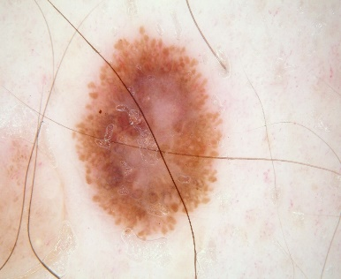
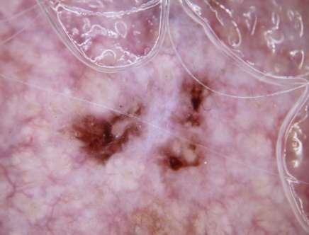
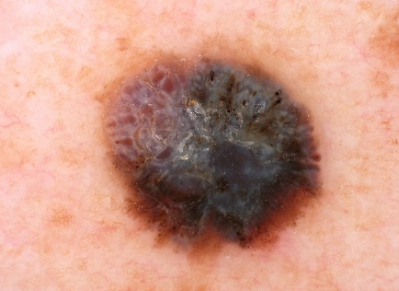
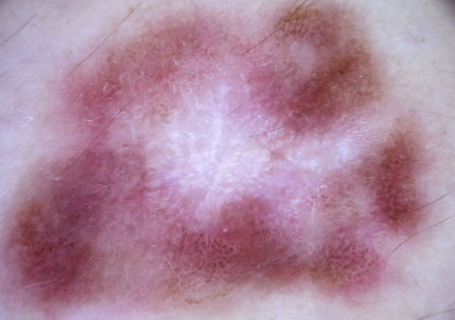
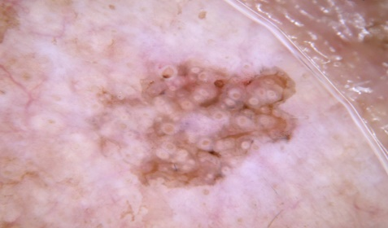
Efforts
This model uses Deep Learning algorithms to identify different types of skin diseases irrespective of skin color.
It provides a high-quality dataset of images containing skin diseases.
The following skin diseases are included :
Seborrheic Keratosis
Actinic Keratosis
Squamous Cell Carcinoma
Melanoma
Dermatofibroma

Slide 7
Conclusion
The main role of this research is to verify the hypothesis that skin disease data can be extricated utilizing integration of vision-based procedures and deep learning algorithms.
By implementing deep learning algorithms, we are able to predict diseases with a higher accuracy level of 91%.
This proves that deep learning algorithms have a huge potential in the real world skin disease diagnosis.

Slide 8
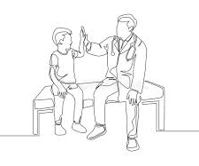
Thank You

